Slide 1
How to form a chunk – Part 1
By Barbara Oakley, PhD

Slide 2
Listen
Watch
Pattern

Slide 3
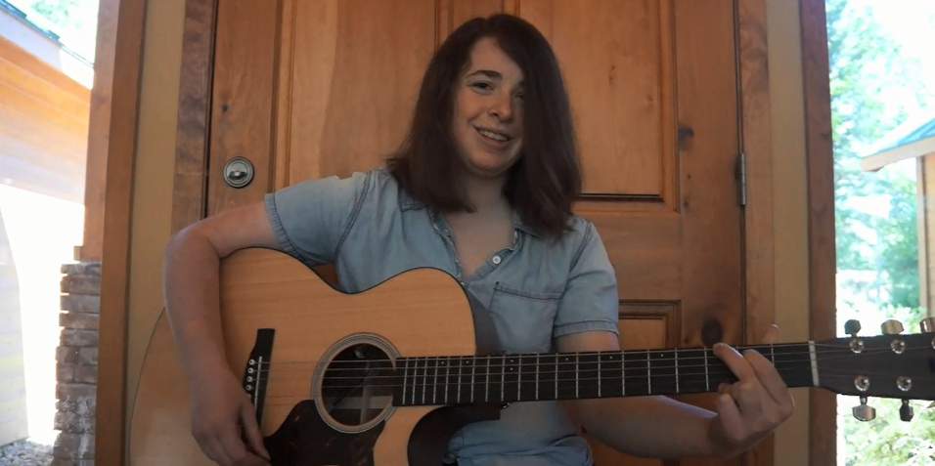
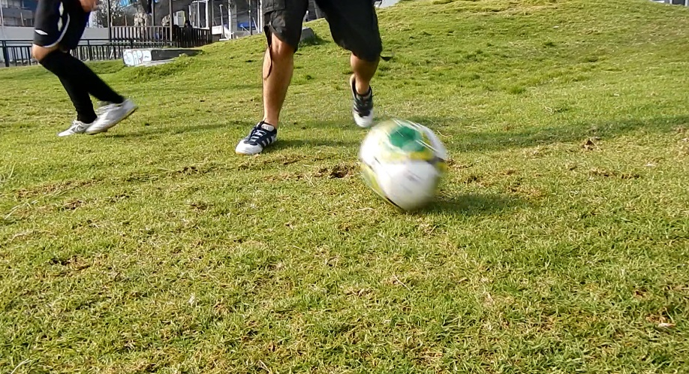

Slide 4
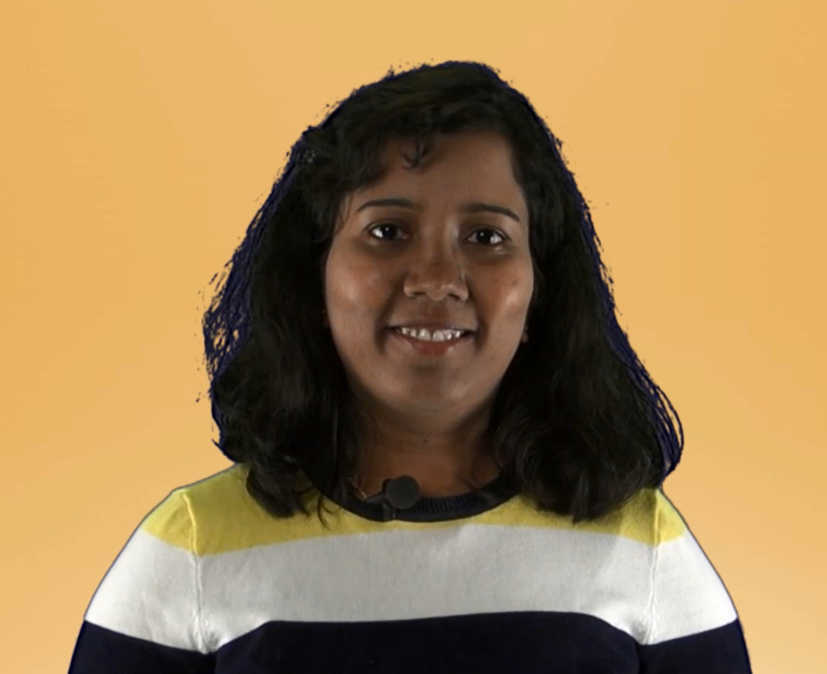
To see what I mean, try repeating the following tongue-twister in the Indian language of Kannada
Not easy, is it? (Unless you are a native speaker of Kannada!)
But the language was
learned bit by bit.

Slide 5
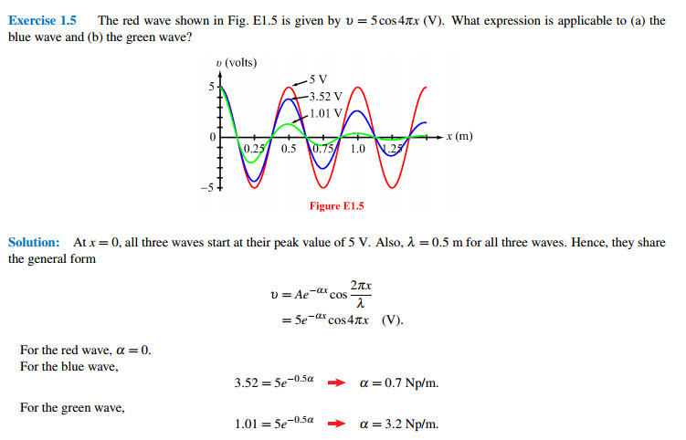

Slide 6
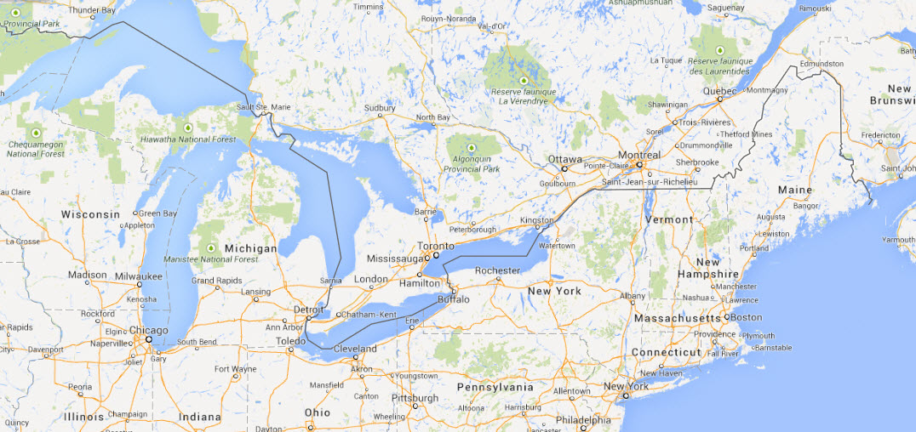

Slide 7
Credits
Example of guitar playing ©Katherine Oakley, 2014. Excerpt from “Somebody Loves You Through It,” by Katherine Oakley, ©Katherine Oakley, 2014, https://www.facebook.com/KatherineOakleyMusic.
Example of soccer playing courtesy Kevin Mendez, ©Kevin Mendez, 2014.
Example of a tongue-twister in Kannada courtesy Ms. Shilpa Konkani, ©Shilpa Konkani, 2014.
Example of an electromagnetics problem from Fundamentals of Applied Electromagnetics 6e, “Exercise Solutions,” by Fawwaz T. Ulaby, Eric Michielssen, and Umberto Ravaioli http://em.eecs.umich.edu/pdf/ulaby_exercise_solutions.pdf
Map from Google Maps.

Slide 8
Relevant Readings
Baddeley, Alan, Michael W. Eysenck, and Michael C. Anderson. Memory. NY: Psychology Press, 2009.
Bransford, John D, A. L. Brown, R. R. Cocking, M Suzanne Donovan, and JW Pellegrino. "How People Learn." Washington, DC: National Academy Press, 2000.
Brent, Rebecca, and Richard M. Felder. "Learning by Solving Solved Problems." Chemical Engineering Education 46, no. 1 (2012): 29-30.
Cho, Soohyun, Arron W. S. Metcalfe, Christina B. Young, Srikanth Ryali, David C. Geary, and Vinod Menon. "Hippocampal-Prefrontal Engagement and Dynamic Causal Interactions in the Maturation of Children's Fact Retrieval." Journal of Cognitive Neuroscience 24, no. 9 (2012): 1849-66.
Cooper, Graham, and John Sweller. "Effects of Schema Acquisition and Rule Automation on Mathematical Problem-Solving Transfer." Journal of Educational Psychology 79, no. 4 (1987): 347.
Cree, George S, and Ken McRae. "Analyzing the Factors Underlying the Structure and Computation of the Meaning of Chipmunk, Cherry, Chisel, Cheese, and Cello (and Many Other Such Concrete Nouns)." Journal of Experimental Psychology - General 132, no. 2 (2003): 163-200.
Gobet, F., and N. Charness, eds. Chess and Games. edited by K. Anders Ercisson, Neil Charness, Paul Feltovich and Robert R. Hoffman, Cambridge Handbook on Expertise and Expert Performance: Cambridge University Press, 2006.
Gobet, F., and G. Clarkson. "Chunks in Expert Memory: Evidence for the Magical Number Four… or Is It Two?". Memory 12, no. 6 (2004): 732-47.
Gobet, F., P.C.R. Lane, S. Croker, P.C.H. Cheng, G. Jones, I. Oliver, and J.M. Pine. "Chunking Mechanisms in Human Learning." Trends in Cognitive Sciences 5, no. 6 (2001): 236-43.
Gobet, Fernand. "Chunking Models of Expertise: Implications for Education." Applied Cognitive Psychology 19, no. 2 (2005): 183-204.
Guida, A., F. Gobet, H. Tardieu, and S. Nicolas. "How Chunks, Long-Term Working Memory and Templates Offer a Cognitive Explanation for Neuroimaging Data on Expertise Acquisition: A Two-Stage Framework." Brain and Cognition 79, no. 3 (Aug 2012): 221-44.
Mastascusa, Edward J., William J. Snyder, and Brian S. Hoyt. Effective Instruction for Stem Disciplines. San Francisco, CA: Jossey Bass, 2011.
Nyhus, E., and T. Curran. "Functional Role of Gamma and Theta Oscillations in Episodic Memory." Neuroscience and Biobehavioral Reviews 34, no. 7 (Jun 2010): 1023-35.
Sweller, John, Paul Ayres, and Slava Kalyuga. Cognitive Load Theory. NY: Springer, 2011.

